Slide 1
Optimum Phase 2 (Baseline)

Slide 2
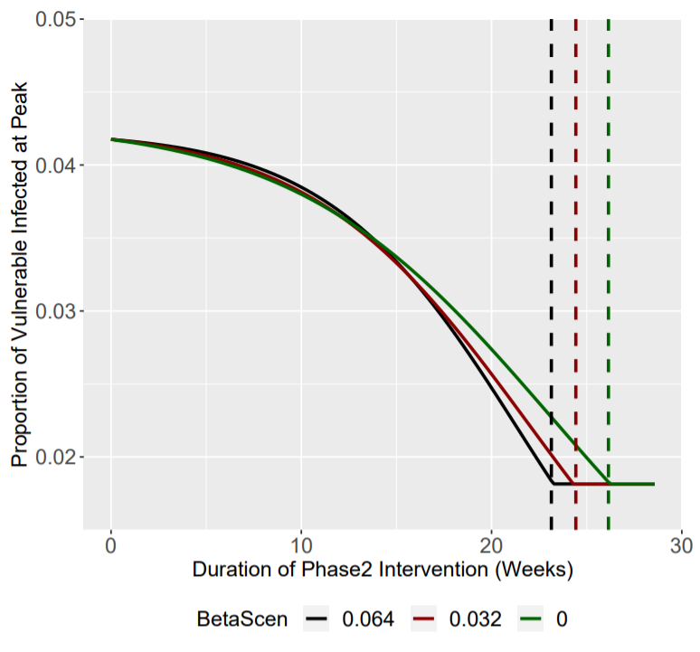
Optimising the Duration of Phase 2
Scenario | Phase 2 Beta1 | Phase 2 Beta2 | Optimum Duration of Phase 2
1 | 0.064 | 0.161 | 23.3 Weeks
2 | 0.032 | 0.161 | 24.4 Weeks
3 | 0 | 0.161 | 26.3 Weeks
We explore the minimum duration of phase 2 needed to keep Iv(t) under 0.0182 at the maximum epidemic peak (after the intervention).
We explore 3 scenarios for phase 2 beta1:
0.064, 0.032 and 0.
We assume that:
Phase 1: 6 Weeks (Beta1 = 0.064)
Phase 3: After Phase 2 Onwards (Beta1 = 0.161)
Intervention is initiated at day 100: Iv(t) = 0.0182
Dashed lines show the minimum duration of phase 2 interventions needed to keep Iv(t) below 0.0182 at the peak

Slide 3
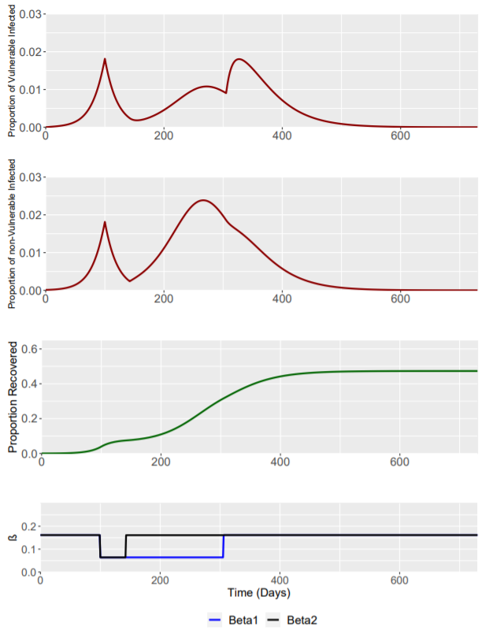
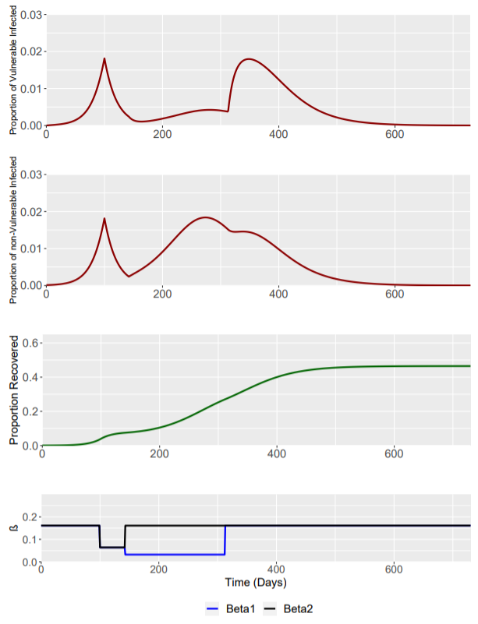
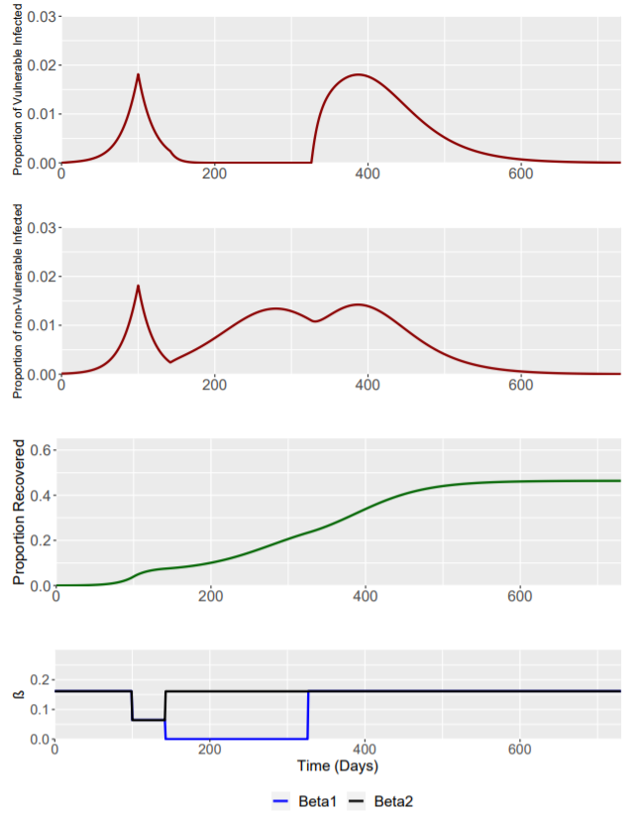
Optimising the Duration of Phase 2 (Beta = 0.064)
Optimising the Duration of Phase 2 (Beta = 0.032)
Optimising the Duration of Phase 2 (Beta = 0)
OPTIMAL PHASE 2 DURATION = 23.3 WEEKS
OPTIMAL PHASE 2 DURATION = 24.4 WEEKS
OPTIMAL PHASE 2 DURATION = 26.3 WEEKS

Slide 4
Scenario | Phase 2 β1 Value | Optimum Duration of Phase 2 | Fraction Infected at 2nd Epidemic Peak (Vulnerable) | Time of 2nd Epidemic Peak (Vulnerable) | Total Fraction Infected (Vulnerable)
1 | 0.064 | 23.3 Weeks (163 Days) | 0.0180 | 327 Days | 0.368
2 | 0.032 | 24.4 Weeks (171 Days) | 0.0179 | 338 Days | 0.348
3 | 0 | 26.3 Weeks (184 Days) | 0.0180 | 387 Days | 0.345
All I(t) values are relative to the population size (initial fraction) in either sub-population.
Initial Starting Population Sizes:
Vulnerable (S): 0.15
Non-Vulnerable (P): 0.85
Initial Conditions are as follows:
S_{S} | S_{P} | I_{S} | I_{P} | R
0.15 | 0.8499 | 0 | 0.0001 | 0

Slide 5
Optimum Phase 2 (RWC)

Slide 6
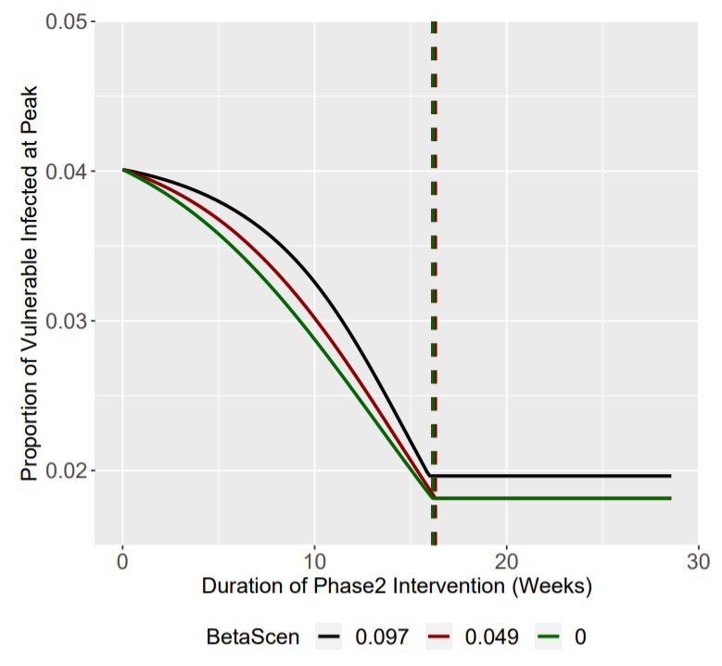
Optimising the Duration of Phase 2
Scenario | Phase 2 Beta1 | Phase 2 Beta2 | Optimum Duration of Phase 2
1 | 0.097 | 0.161 | NO OPTIMUM
2 | 0.049 | 0.161 | 16.3 Weeks
3 | 0 | 0.161 | 16.1 Weeks
We explore the minimum duration of phase 2 needed to keep Iv(t) under 0.0182 at the maximum epidemic peak (after the intervention).
We explore 3 worst case scenarios for phase 2 beta1:
0.097, 0.049 and 0.
We assume that:
Phase 1: 6 Weeks (Beta1 = 0.097)
Phase 3: After Phase 2 Onwards (Beta1 = 0.161)
Intervention is initiated at day 100: Iv(t) = 0.0182
Dashed lines show the minimum duration of phase 2 interventions needed to keep Iv(t) below 0.0182 at the peak
Only scenario 2 and 3 have an optimum duration

Slide 7
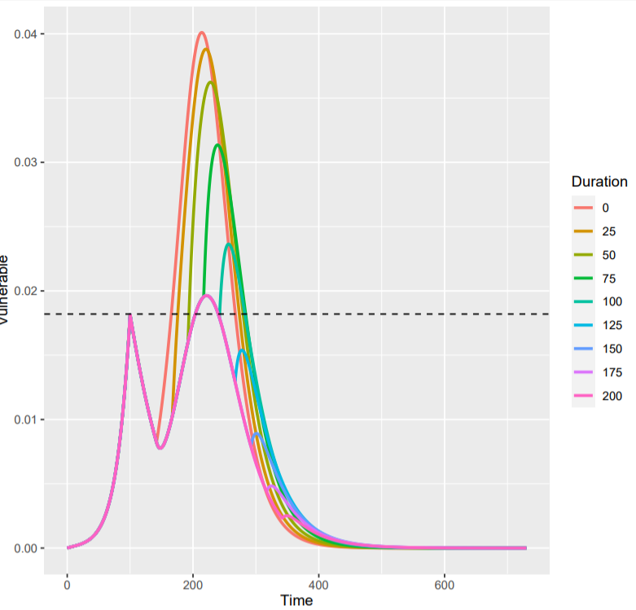
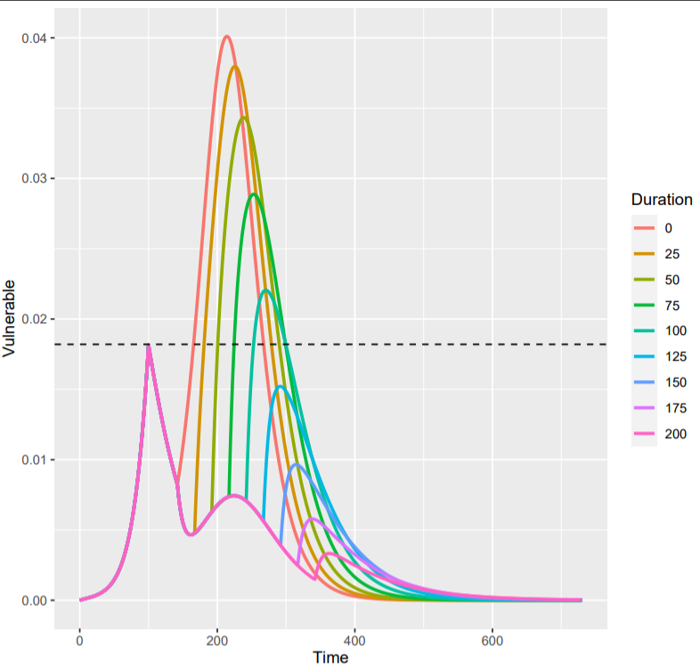
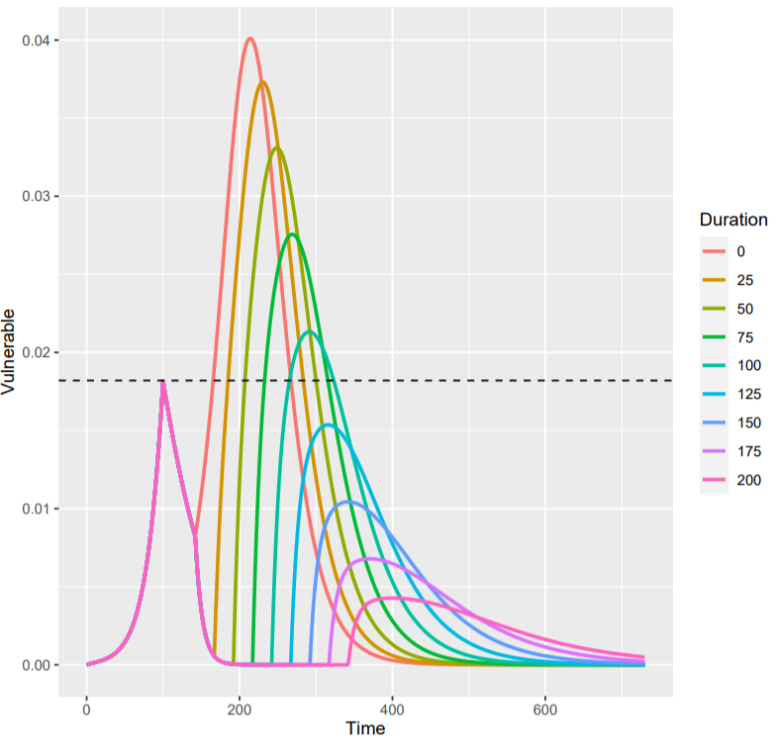
Describing the RWC Optimum Phase 2 Phenomenon
Phase 2 β1 of 0.097 is unable to prevent a secondary peak above the pre-intervention Iv(t) = 0.0182, while phase 2 β1 of 0.049 and 0 are able to prevent this secondary peak.
This is because a phase 2 β1 = 0.097 results in a secondary peak with a minimum height that is above Iv(t) = 0.0182 no matter how long the intervention is.
While for β1 = 0.049 and 0, the interventions are “strong” enough to push the secondary peak below 0.0182 with a long enough intervention.
Interestingly, the β1 = 0.049 and 0 interventions have extremely similar optimum intervention durations to drive Iv(t) > 0.0182 at the secondary peak
Phase 2 β1 = 0.097
Phase 2 β1 = 0.049
Phase 2 β1 = 0

Slide 8
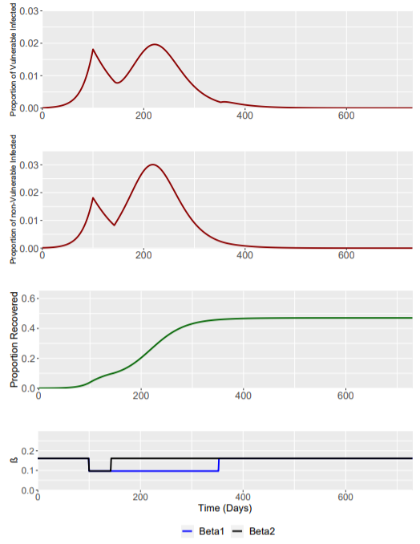
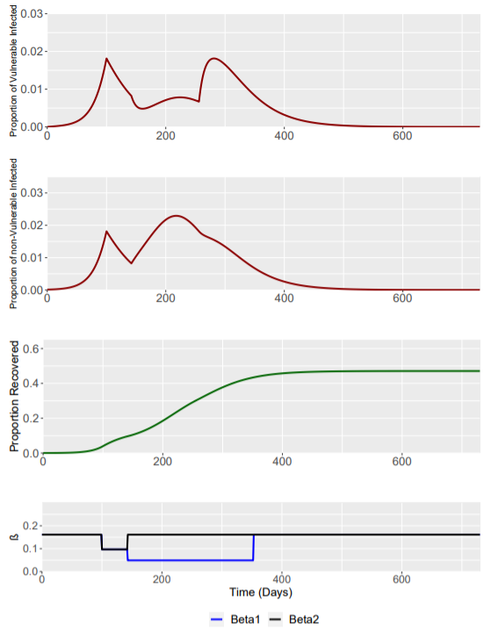

Optimising the Duration of Phase 2 (Beta1 = 0.097)
Optimising the Duration of Phase 2 (Beta1 = 0.049)
Optimising the Duration of Phase 2 (Beta1 = 0)
OPTIMAL PHASE 2 DURATION = NO OPTIMUM
(Figure is for 30 Weeks)
OPTIMAL PHASE 2 DURATION = 16.3 WEEKS
OPTIMAL PHASE 2 DURATION = 16.1 WEEKS

Slide 9
Scenario | Phase 2 β1 Value | Optimum Duration of Phase 2 | Fraction Infected at 2nd Epidemic Peak (Vulnerable) | Time of 2nd Epidemic Peak (Vulnerable) | Total Fraction Infected (Vulnerable)
1 | 0.097 | NO OPTIMUM | Always at least = 0.020 | 222 Days | 0.365
2 | 0.049 | 16.2 Weeks (114 Days) | 0.0182 | 281 Days | 0.367
3 | 0 | 16.1 Weeks (113 Days) | 0.01813238 | 304 Days | 0.353
All I(t) values are relative to the population size (initial fraction) in either sub-population.
Initial Starting Population Sizes:
Vulnerable (S): 0.15
Non-Vulnerable (P): 0.85
Initial Conditions are as follows:
S_{S} | S_{P} | I_{S} | I_{P} | R
0.15 | 0.8499 | 0 | 0.0001 | 0

